Slide 1

SQL PROBLEM STATEMENT ASSIGNMENT
As a data analyst at a fast-growing restaurant company, you are responsible for improving the current ways of managing the inventory and creating business intelligence to support the company's decisionmaking process. Your primary goal is to optimize the cost management and profitability of the company. To achieve this goal, you need to study the current database schema and ways of storing the data, and then create a new way of storing and managing the inventory of restaurants in a more effective and efficient manner

Slide 2
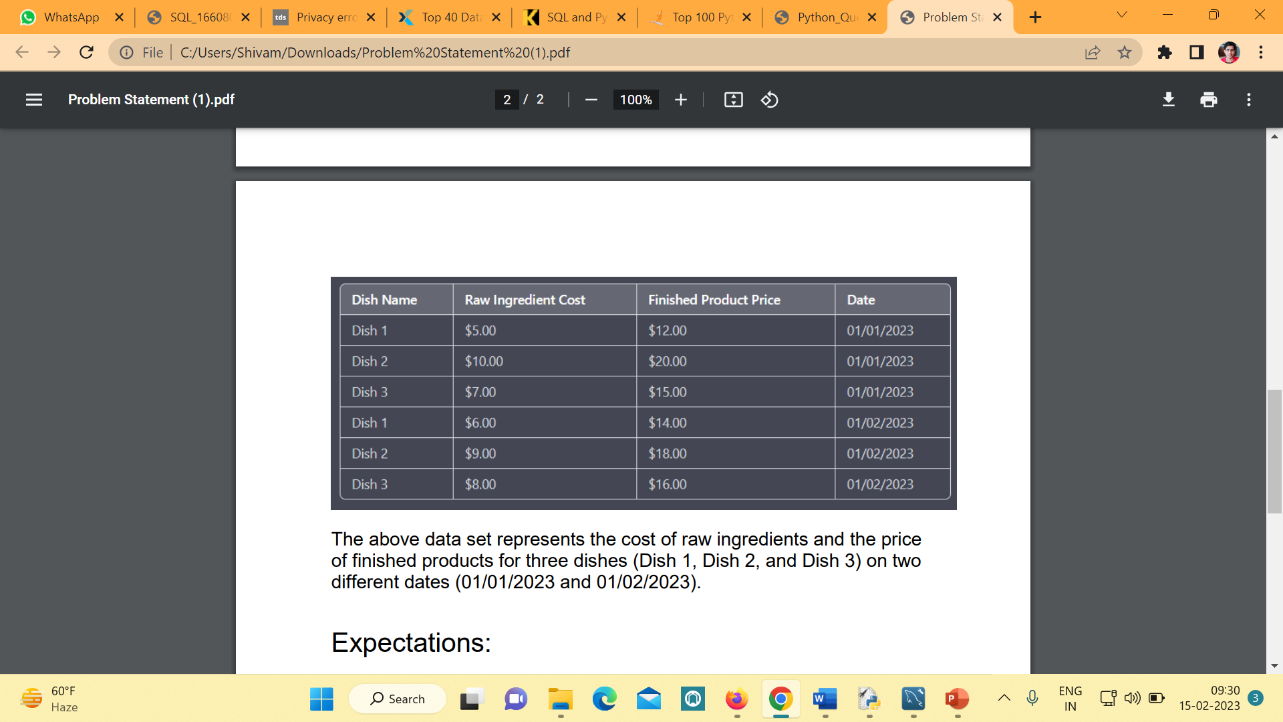
Old database schema

Slide 3
To optimize the cost management and profitability of the restaurant, we need to create a new database schema that allows for more efficient and effective management of inventory and cost data.
Here is an example of a new database schema by using normalization :
Dish table
dish_id (integer , primary key)
dish_name ( string )
description ( string )
category ( string )

Slide 4
Row Ingredient table
id (integer, primary key)
name (string)
unit_cost (decimal)
Dish Ingredient table (many-to-many relationship between Dish and Ingredient)
dish_id (foreign key to Dish table)
ingredient_id (foreign key to Ingredient table)
ingredient_quantity

Slide 5
Cost table
cost_id (primary key)
ingredient_id (foreign key to Ingredient table)
date
cost_per_unit
Sale table
sales_id (primary key)
dish_id (foreign key to Dish table)
date
quantity_sold
price

Slide 6
By using this schema, we can efficiently calculate the cost of producing each dish by multiplying the ingredient cost per unit by the ingredient quantity.
We can also calculate the profit margin for each dish by subtracting the total cost from the total revenue (price multiplied by quantity sold).
This schema also allows for efficient inventory management by tracking the quantity of each ingredient used in each dish and when it was last purchased.
This can help us manage inventory levels, reduce waste, and optimize purchasing decisions.

Slide 7
Calculate the total cost of each dish based on the ingredient costs
Join the Dish Ingredient table with the Ingredient table to get the unit cost of each ingredient for the dish.
Multiply the unit cost by the ingredient quantity to get the cost per ingredient for the dish.
Sum up the cost per ingredient for all ingredients in the dish to get the total cost of the dish.
Calculate the total revenue for each dish based on the sales data
Join the Sales table with the Dish table to get the dish name and price for each sale.
Multiply the price by the quantity sold to get the revenue for each sale.
Sum up the revenue for all sales of the dish to get the total revenue of the dish.

Slide 8
Calculate the profit margin for each dish
Subtract the total cost from the total revenue to get the profit for the dish.
Divide the profit by the total revenue and multiply by 100 to get the profit margin as a percentage.
Identify the high-performing dishes
Calculate the profit margin for each dish using the method described earlier.
Sort the dishes by profit margin in descending order to identify the most profitable dishes.
Analyze the ingredients and the cost of each high-performing dish to identify any patterns or trends.

